Slide 1
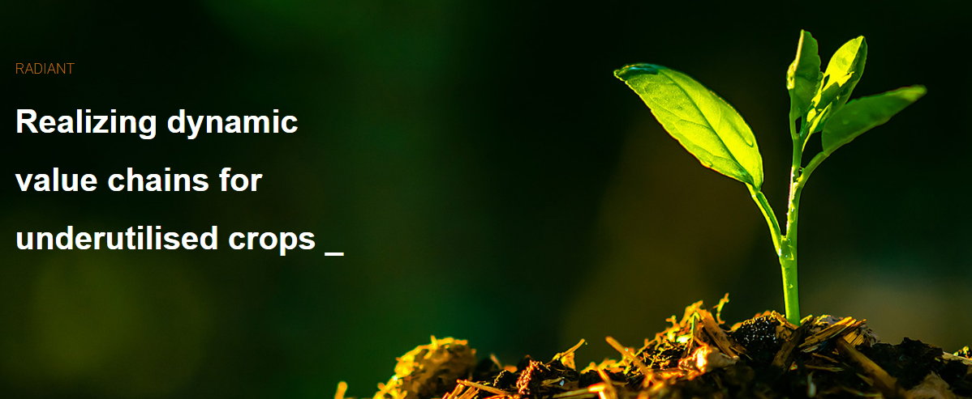


| Pietro Iannetta
| The James Hutton Institute
| Universidade Católica Portuguesa (CBFQ, Porto)
Commercialising underutilised crops:
connecting growers, value chains and markets
www.radiantproject.eu/ (2021-25)

Slide 2

Question received
Nigel Padbury
Seeds & Marketing Manager
What evidence of demand justifies investment in a new crop?
How can growers, intermediaries and buyers develop supply and demand together?

Slide 3

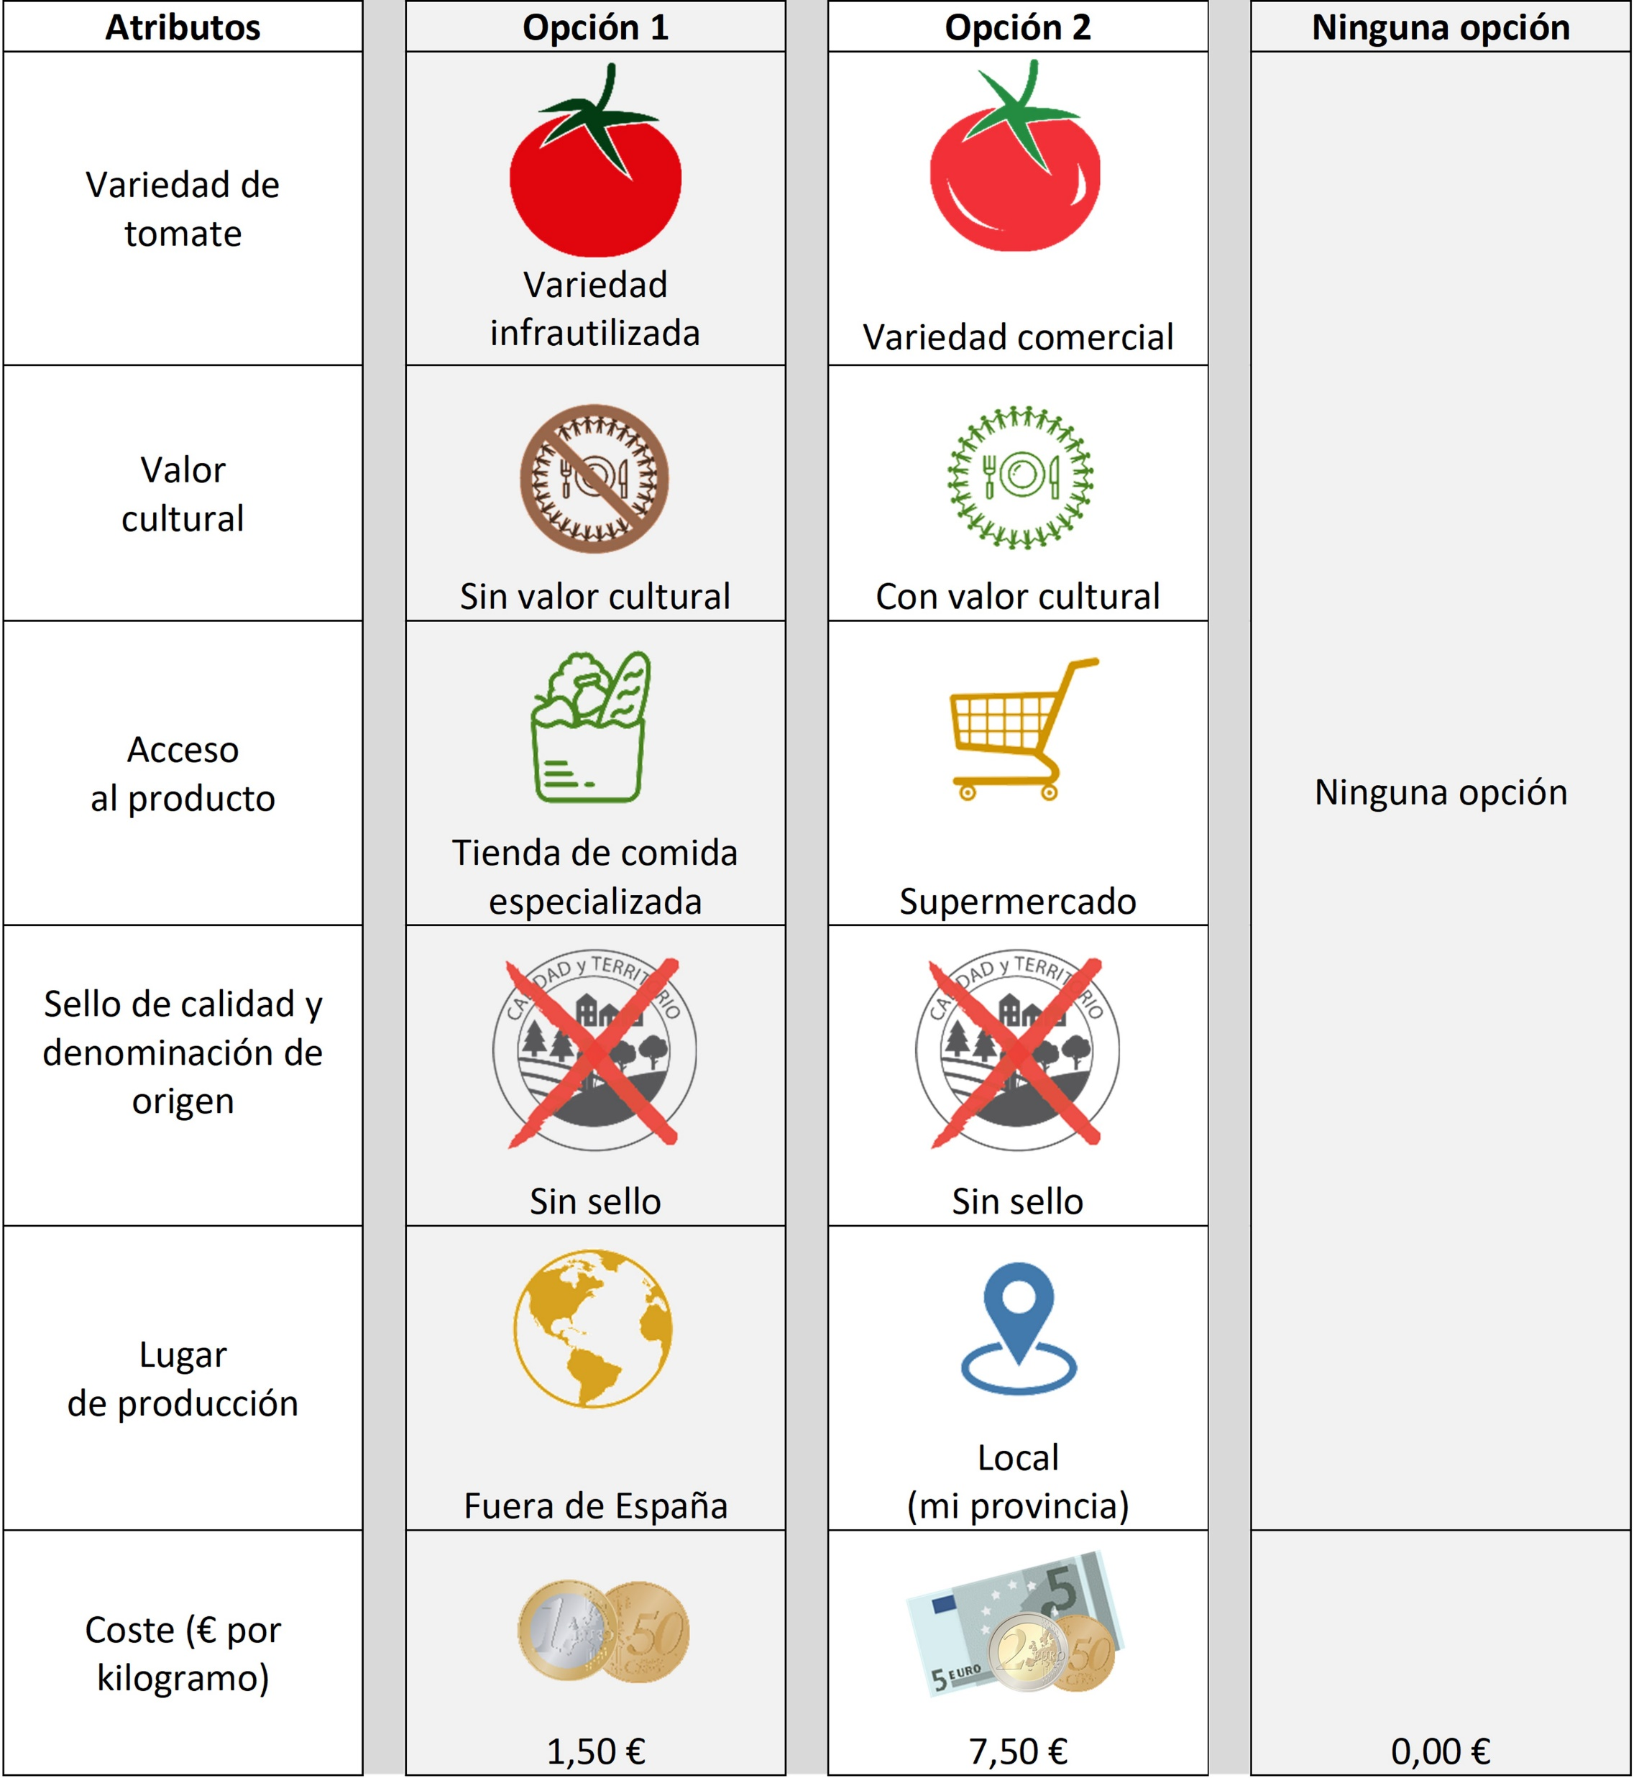
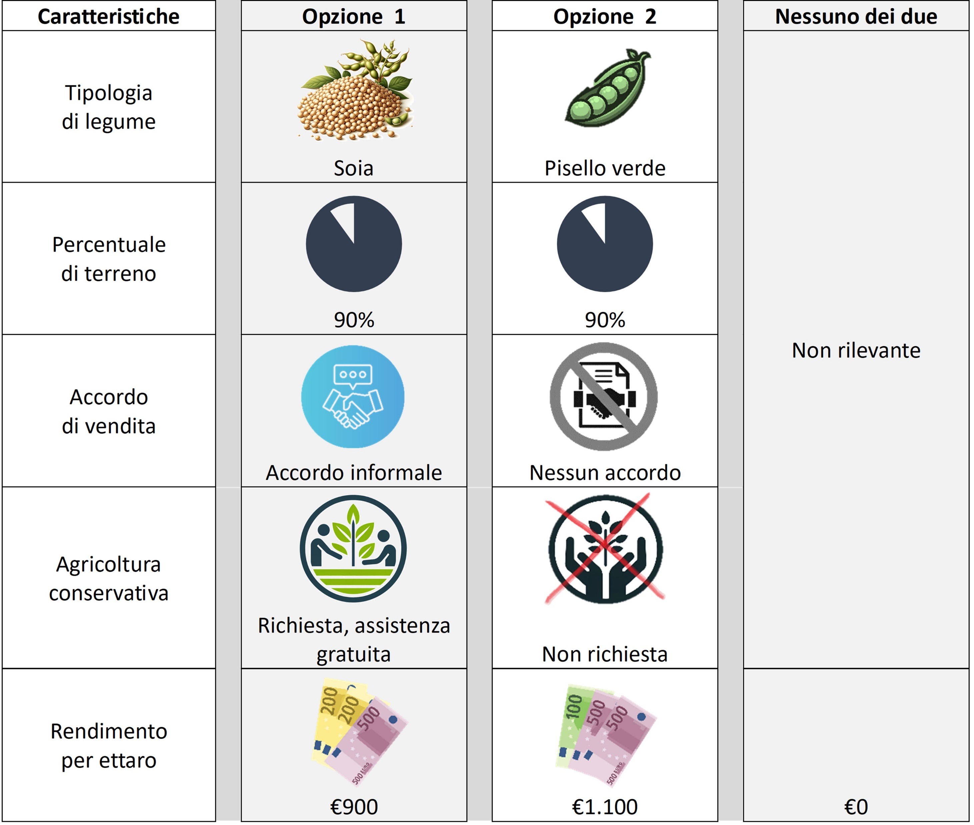
Farmers’ and consumers’ expectations and preferences for underutilised crops (UCs)
Objective: identify basis of willingness-to-accept or -pay for Ucs, or UC-based products.
  Bere barley - shortbread biscuits – Scotland.
  Hanging tomatoes - Benlloc variety – Spain.
  IDEAL tomatoes - fresh consumption – Bulgaria.
  Yellow pea & einkorn wheat - pasta – Italy.
  Crop mixtures (forage grass/leguminous) - Parmigiano Reggiano – Italy.
Basis for the results obtained
  90 farmers & 90 consumers - focus groups - CREATOR workshops.
  331 farmers consulted in choice experiment & public good game (Italy).
  1,668 consumer surveys (EU wide).
Research Leader, Agricultural & Rural Economist - Simone.Piras@hutton.ac.uk

Slide 4
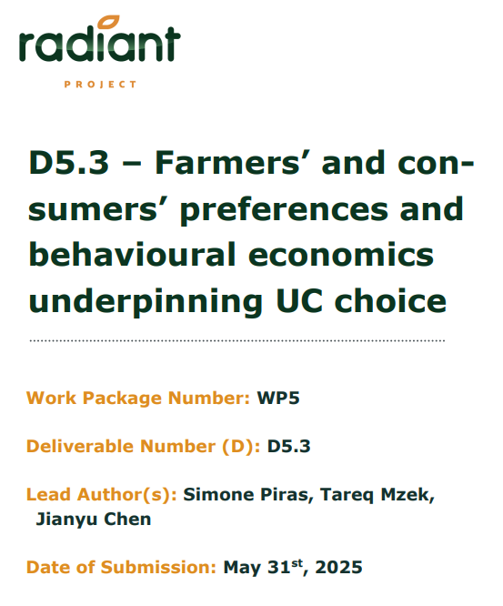
Farmers’ expectations and preferences for UCs
What matters for farmers when selecting the crops for their farming (crop sequence) plans?
Attitude towards UCs is crop-specific
  yellow pea & Benlloc tomato = acceptable;
  novel fodder mixtures, less so.
    Nevertheless, realising UC-opportunity is attractive.
Farmers are cautious/need for risk reduction
  Devote only small share of the farm area to UCs.
  Sales contracts, crop stress tolerance, and free ag. advice.
Public good game insight
  The public-good game suggests there is scope or more farmer cooperatives to assemble and support viable value chains
“Farmers expect incentives for UCs to be more easily accessible, and available over longer periods. Otherwise, these are not trusted. Ensuring consistent demand of UCs downstream is key for adoption”
Research Leader, Agricultural & Rural Economist - Simone.Piras@hutton.ac.uk

Slide 5
Consumers’ expectations and preferences for UCs
What matters for consumers when choosing food products that may derive from UCs?
Preferences are UC-specific
  Acceptance is strongly linked to reinforcing cultural heritage
  (Bere, IDEAL tomato).
  Technical terms like “underutilised” or “hybrid” should be avoided.
  Ecological and social benefits had limited influence on choice.
Labels of quality and territorial connection
  Attract higher stated willingness to pay in these case studies.
Other important attributes when marketing UCs to consumers
  Higher nutritional value; and
  lower price also matter.
“Consumers care about heritage and provenance and are aware of compromising these aspects by up-scaling for purely commercial purposes. Up-scaling production should not jeopardise UC links with territory or culture.”
Research Leader, Agricultural & Rural Economist - Simone.Piras@hutton.ac.uk

Slide 6
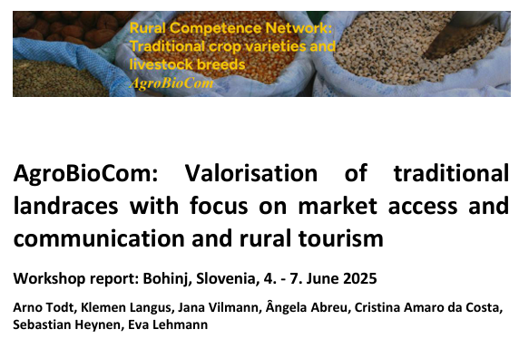

AgroBioNet - Value creation with old varieties and ancient breeds
AgroBioCom_Bohinj_report_0925.pdf
Distinctive taste, provenance, agronomic adaptation and biodiversity value can underpin differentiated products when matched with processing and market channels.
Champagne rye and emmer beer show the potential for premium prices and meaningful market growth.
Growers need reliable buyers, quality specifications and returns that compensate for lower yields or added risk.
A coordinating actor can connect growers, processors and markets so that supply and demand develop together.
Arno Todt
Nova Institute
Arno Todt - nova-Institut GmbH | LinkedIn

Slide 7
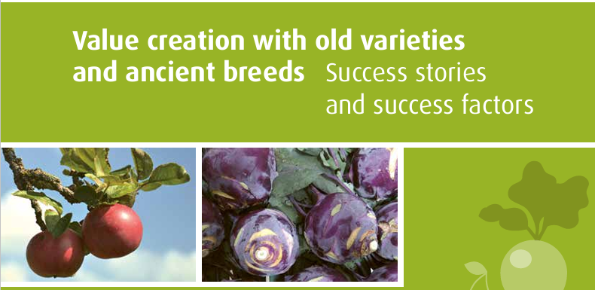
AgroBioCom - Landrace valorisation and market access
Wertschöpfung mit alten Sorten und alten Rassen – Erfolgsgeschichten und Erfolgsfaktoren
Branding, certification and storytelling can support premiums by communicating quality, provenance and cultural identity.
Direct sales, markets, festivals, gastronomy and tourism help introduce unfamiliar crops and explain their value.
Collective or territorial brands can bring producers together around shared standards for quality, provenance and promotion.
Business links to processors, restaurants, hotels and retailers need active coordination across the value chain.
Arno Todt
Nova Institute
Arno Todt - nova-Institut GmbH | LinkedIn

Slide 8
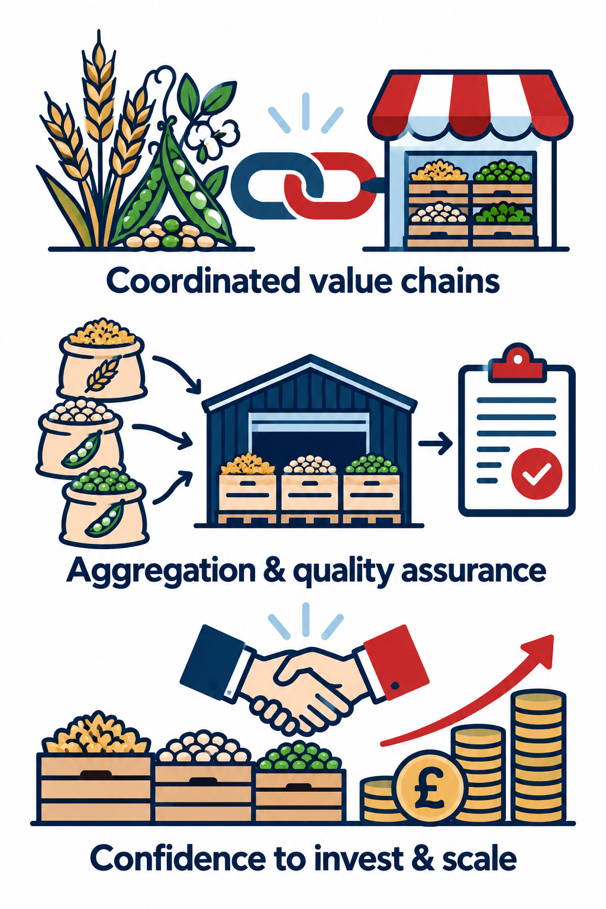
Shared message for commercialisation
Promising crops need coordinated value chains to reach viable markets.
An intermediary or aggregator can contract growers, assemble supply and assure specifications and quality for buyers.
Reliable supply and market commitments give growers and users confidence to invest and scale.
Agree buyer specifications and indicative volumes → pilot production and processing → test costs and repeat demand → scale through shared commitments.

Slide 9
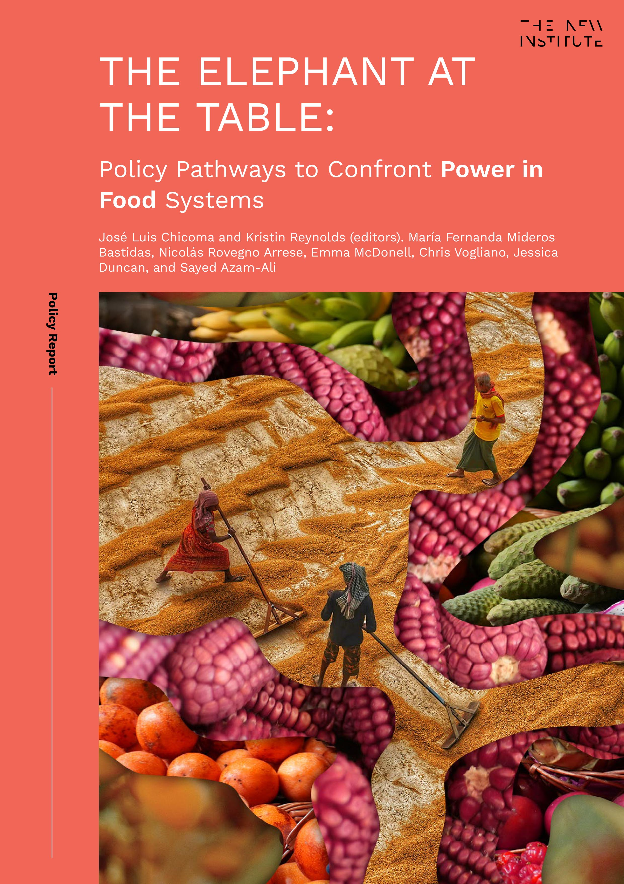
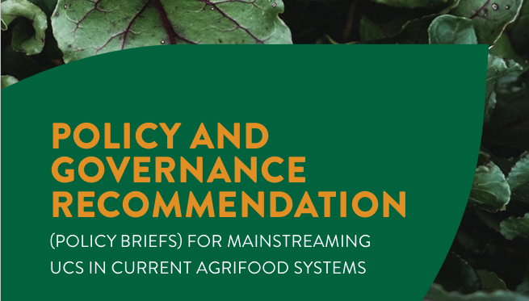
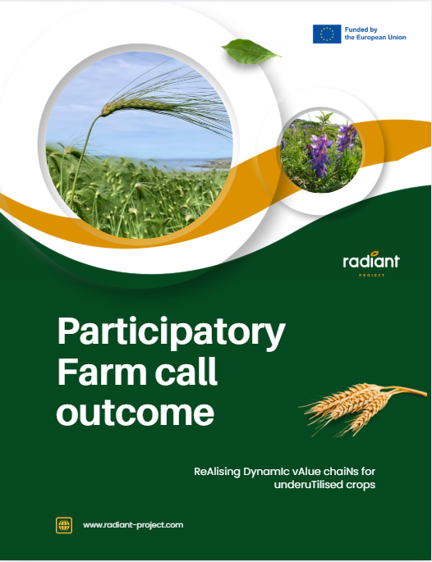
Publications
Azam-Ali, S. N., and E. Jahanshiri. "Forgotten foods: a manifesto for the future of the food system?." XXXI International Horticultural Congress (IHC2022): International Symposium on Conservation and Sustainable Use of 1384. 2022.
Azam-Ali, S. N., Gregory, P. J., & Jahanshiri, E. (2024). Diversifying the UK Agrifood System: A Role for Underutilised Crops. doi: 10.20944/preprints202403.1420.v1
RADIANT D5.5: Policy and governance recommendations (2025)
THE ELEPHANT AT THE TABLE: Policy Pathways to Confront Power in Food Systems
THE NEW INSTITUTE

Slide 10
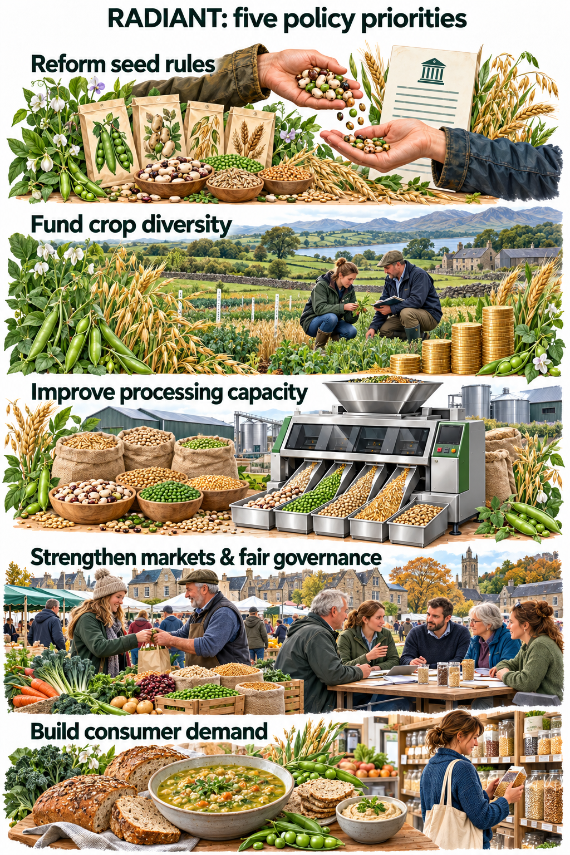
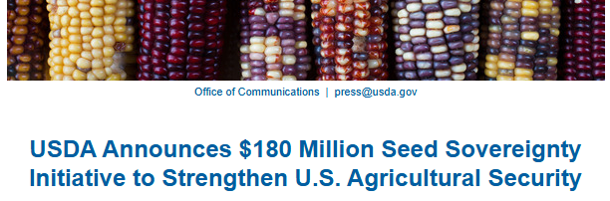
Policy and governance changes
Reform seed rules: simplify and reduce the cost of registering diverse seed material; enable farmers to save, use, exchange and sell their seeds.
Improve processing capacity: support affordable, accessible production and processing technologies, including local processing and shared access to innovation.
Strengthen markets and fair governance: support short supply chains and collaboration; address concentrated market power and give smaller farmers and other underrepresented groups a stronger policy voice.
Build consumer demand: invest in food education, highlight nutritional benefits, protect food heritage and make better use of existing labelling schemes.
Fund crop diversity: provide targeted incentives for growing underutilised crops and long-term support for breeding, including participatory breeding and locally adapted varieties.​ Accounting existing investment, and relative population scales, this value would equate to a £25–30 million for the UK.

